Slide 1
Micro-Credit Defaulter Model

Slide 2
Domain Knowledge
The Telecom company collaborating with an MFI(microfinance institutions ) to provide micro-credit on mobile balances to be paid back in 5 days.
The Consumer is believed to be defaulter if he deviates from the path of paying back the loaned amount within the time duration of 5 days.

Slide 3
Problem Statement:
Predict in terms of a probability for each loan transaction, whether the customer will be paying back the loaned amount within 5 days of insurance of loan.
Label ‘1’ indicates that the loan has been payed i.e. Non- defaulter.
Label ‘0’ indicates that the loan has not been payed i.e. defaulter

Slide 4
EDA
After analysing the data set, the following observation has been made:
The shape of data set 209593 rows × 37 columns, which shows that the number of attributes is 37 in number.
There are no null values in the data set.
The data set is imbalanced, which was resolved by SMOTE technique.
After analysing the data, it has been seen that the data set is distributed for 30 days and 90 days and representing majorly same relationship.
pcircle has same value so it can be dropped. And date parameter as no direct relationship with label so it can be dropped

Slide 5
Data Preprocessing
Firstly, I have analysed, each attribute and seen that the 90 days data can be considered for futher analysis and thus reduced the dimension of data set. Also delete the data set with no relation with the label prediction. Also the attributes having high correlation shown in the heat map.
There were lot of outliers so, z score has been used and fixed the threshold at 3, and reduced the skewness.

Slide 6
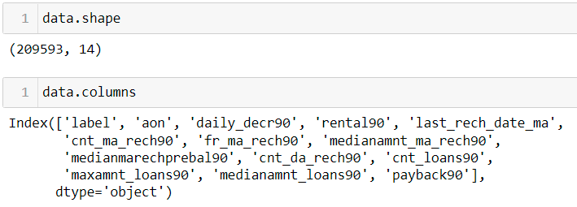
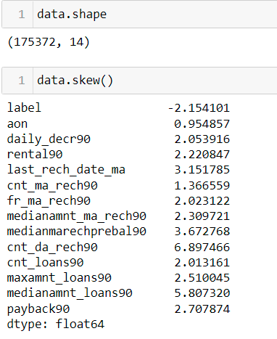

Slide 7
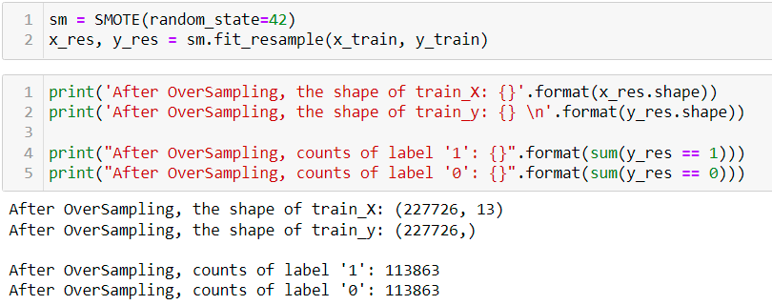
SMOTE technique is used to balance it.

Slide 8
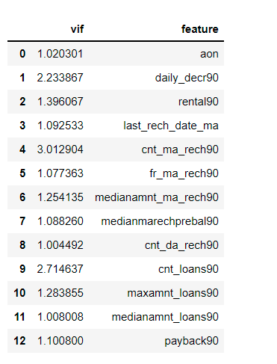
varience has been checked:

Slide 9
Model/s Development
The following algorithms used:
Linear Regression
Random Forest

Slide 10
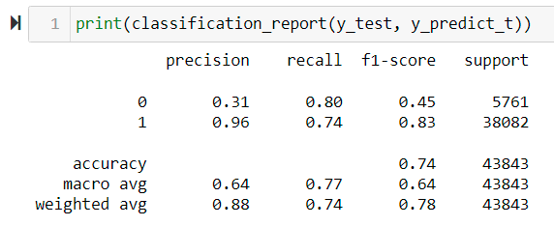
Logistic Regression

Slide 11
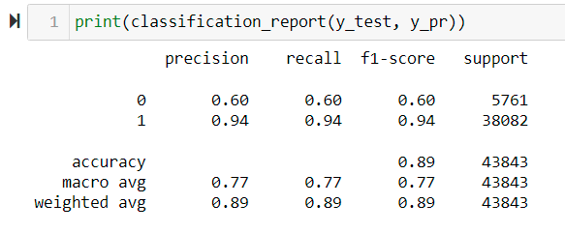
Random Forest

Slide 12
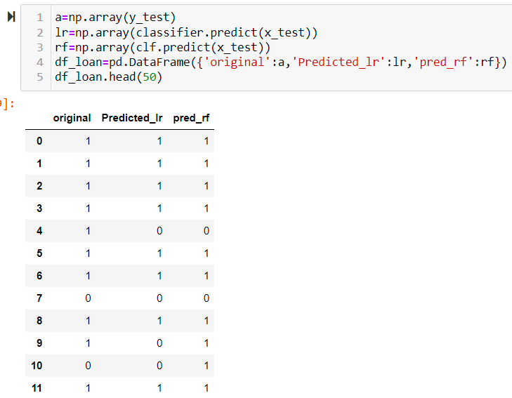
Conclusion:

Slide 13
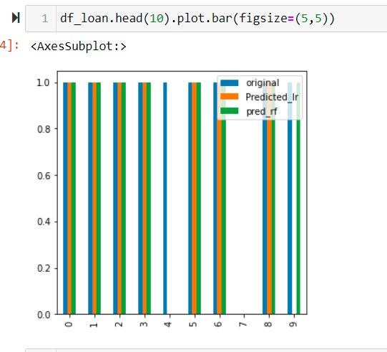
Conclusion

